Slide 1
Econ 200 Lecture 7

Slide 2
Outline
Price Incentives
Taxes
Subsidies
Examples
Readings: Chapter 6

Slide 3
Taxes and Subsidies
Price incentives can be divided into categories:
Taxes: Either the buyer or the seller must pay some extra amount to the government on top of the sale price.
Typically placed on seller.
Subsidies: Either the buyer or the seller receives a payment from the government that lowers the sale price.

Slide 4
Taxes
Why might the government use taxes or subsidies for redistribution rather than price ceilings or floors?
→Taxes reduce consumption and provide a new source of public revenue.
→Subsidies increase consumption but cost the government money.
We will look at burdens/benefits to buyers and sellers, distributional effects, and deadweight loss of these policies.

Slide 5
Effects of a Tax Paid by the Seller
Price
($)
The new supply curve adds $0.20 to all prices, the amount of the tax.
Taxes drives a wedge between the buyer’s price and the seller’s price.
The equilibrium quantity decreases from 30 million to 25 million.
0.80
S
2
S
1
Buyers pay $0.60
E
2
0.60
E
1
Tax Wedge
0.40
Sellers receive $0.40
after the tax
D
0.20
0
5
1
0
1
5
2
0
2
5
3
0
3
5
4
0
4
5
Quantity of Whizbangs (millions)

Slide 6
Effects of a Tax Paid by the Seller
Deadweight loss
The tax revenue generated is
TR = Tax × Q_{post-tax}
Tax revenue is a transfer from consumers and producers to the government.
Price ($)
S
2
0.80
S
1
Quantity sold = 25 million
E
2
0.60
Tax revenue = $5 million
($0.20 *25 million)
E
1
Tax
= $0.20
0.40
D
0.20
0
5
1
0
1
5
2
0
2
5
3
0
3
5
4
0
4
5
Quantity of Whizbangs (millions)

Slide 7
Effects of a Tax Paid by the Seller
Deadweight loss occurs from loss of quantity sold.
CS and PS may shrink.
Deadweight loss
Price ($)
S
2
0.80
S
1
Quantity sold = 25 million
E
2
0.60
Tax revenue = $5 million
($0.20 *25 million)
E
1
Tax
= $0.20
0.40
D
0.20
0
5
1
0
1
5
2
0
2
5
3
0
3
5
4
0
4
5
Quantity of Whizbangs (millions)

Slide 8
Effects of a Tax Paid by the Buyer
The new demand curve is $0.20 lower, the amount of the tax.
Taxes drives a wedge between the buyer’s price and the seller’s price.
The equilibrium quantity decreases from 30 million to 25 million.
Price ($)
0.80
S
Buyers pay $0.60
0.60
E
1
Tax Wedge
0.40
E
Sellers receive $0.40
2
D
1
0.20
D
2
0
5
1
0
1
5
2
0
2
5
3
0
3
5
4
0
4
5
Quantity of Whizbangs (millions)

Slide 9
Tax Incidence
Suppose the government imposes a $0.20 tax on each unit sold, which the seller must pay. Who bears the burden, or tax incidence, of a tax?
→Whichever side of the market is more price elastic will shoulder less of the burden.
Price ($)
S
Price ($)
S
Price ($)
2
Buyers pay $0.54, sellers receive $0.34
2
S
2
S
S
$0.66
$0.60
1
1
S
$0.54
1
D
$0.46
$0.40
D
D
$0.34
Buyers pay $0.60, sellers receive $0.40
Buyers pay $0.66,
sellers receive $0.46
25
3
0
22
3
0
22
30
Quantity of Whizbangs (mil.)
Quantity of Whizbangs (mil.)
Quantity of Whizbangs (mil.)
Sellers’ tax burden
Buyers’ tax burden
Notes:
Since a tax effectively changes the price of a good to both buyers and sellers, the relative responsiveness of supply and demand will determine the tax burden. Essentially, the side of the market that is more price elastic will be more able to adjust to price changes and will shoulder less of the tax burden. In the figure on the left, the tax burden is shared equally, since consumers lose the same amount of surplus as producers. In the middle figure, buyers paid $0.50 before the tax. After the tax, they pay $0.54, so their tax burden is $0.04 per Whizbang. Sellers, on the other hand, receive only $0.34 after the tax, so their tax burden, at $0.16 per Whizbang, is four times as large as that of buyers. In the figure on the right, buyers bear more of the burden than sellers. Buyers pay $0.66 and sellers receive $0.48. The relative tax burden borne by buyers and sellers is called the tax incidence.

Slide 10
Welfare Effects of a Tax
S+tax
P
When the tax is introduced, the consumer and producer surplus fall.
S
Tax revenue is the amount of the tax times the new quantity consumed.
t
DWL = ½ t ΔQ
D
Q
ΔQ

Slide 11
Subsidies
Using the case of tortillas in Mexico, rather than using price controls, what would happen if the government subsidized them?
Subsidies have two primary effects.
Encourages production and consumption of the good that is subsidized.
Government provides money through the subsidy to producers who continue to sell the good.
Notes:
Students can think of a subsidy as the reverse of a tax.

Slide 12
Subsidies
Suppose the government imposes a $0.35 subsidy on each unit sold, which the seller receives. What effect does this have on the market?
Price ($/lb.)
A new supply curve subtracts $0.35 from all prices, the amount of the subsidy.
Buyers pay $0.53.
Sellers receive $0.88.
The equilibrium quantity increases by 12 million tortillas.
S
1
0.88
S
2
0.70
E
1
0.53
E
2
D
50
62
Quantity of Tortillas (millions of lbs.)
Notes:
The subsidy is placed on the supply curve and the demand curve does not change.
Notice that the equilibrium quantity increases while:
- The price paid by consumers is lower than the equilibrium price.
- The price received by suppliers is higher than the equilibrium price.
The government has to pay for the subsidy, the cost of which equals the amount of the subsidy times the new equilibrium quantity.
A subsidy benefits both buyers and sellers, increasing total surplus within the market. However, the subsidy imposes a cost on the government, and ultimately on taxpayers. The consumers who benefit from the subsidy may not be the same as those paying the taxes.

Slide 13
Deadweight Loss from Subsidy
Suppose the government imposes a $0.35 subsidy on each unit sold, which the seller receives. What effect does this have on the market?
Price ($/lb.)
Deadweight loss
Subsidy causes overproduction.
Overproduction causes welfare loss.
Measured as deadweight.
S
1
0.88
0.70
E
1
0.53
E
2
D
50
62
Quantity of Tortillas (millions of lbs.)

Slide 14
Government Expenditures from Subsidy
The deadweight loss from the tax on sellers can be calculated.
Price ($/lb.)
Government expenditure (GE) on the subsidy can be calculated
GE = Subsidy × Q_{post-subsidy}
The cost of this program is $0.35 × 62 M = $21.7 million.
S
1
0.88
Government expenditure
= $21.7 million ($0.35 *62 million)
0.70
E
1
0.53
E
2
D
50
62
Quantity of Tortillas (millions of lbs.)

Slide 15

Changes in CS and PS from Subsidy
Both consumer and producer surplus increase, but not enough to offset the cost of the subsidy. The difference is the deadweight loss.
Price ($/lb.)
Price ($/lb.)
S
1
S
1
0.88
0.88
0.70
E
1
0.70
E
1
0.53
E
2
0.53
E
2
D
D
50
62
50
62
Quantity of Tortillas (millions of lbs.)
Quantity of Tortillas (millions of lbs.)
Consumer surplus
Producer surplus
Notes:
The additional consumer surplus is ($0.70 - $0.53) × 50 + .5 × ($0.70 - $0.53) × (62 - 50) = $9.52 M
The additional producer surplus is ($0.88 - $0.70) × 50 + .5 × ($0.88 - $0.70) × (62 - 50) = $10.08 M

Slide 16
Government Intervention: A Summary
Intervention
Reason for using
Effect on price
Effect on quantity
Who gains and who loses?
Price floor
T
o protect producers’
Price cannot go
Quantity demanded
Producers who can sell all
income
below the set
decreases and quantity
their goods earn more revenue
minimum.
supplied increases,
per item; other producers are
creating excess supply.
stuck with an unwanted excess
supply.
Price ceiling
T
o keep consumer
Price cannot go
Quantity demanded
Consumers who can buy all the
costs low
above the set
increases and quantity
goods they want benefit; other
maximum.
supplied decreases,
consumers suffer from shortages.
creating a shortage.
T
ax
T
o discourage an
Price increases
.
Equilibrium quantity
Government receives increased
activity or collect
decreases.
revenue; society may gain if the
money to pay for its
tax decreases socially harmful
consequences; to
behavior.
Buyers and sellers of
increase government
the good that is taxed share the
revenue
cost. Which group bears more
of the burden depends on the
price elasticity of supply and
demand.
Subsidy
T
o encourage an
Price decreases
.
Equilibrium quantity
Buyers purchase more goods
activity; to provide
increases.
at a lower price. Society may
benefits to a certain
benefit if the subsidy encourages
group
socially beneficial behavior.
The
government and ultimately the
taxpayers bear the cost.

Slide 17
How big is the effect of a tax or subsidy?
Can the effect of a tax or subsidy on the equilibrium quantity be predicted ahead of time?
Yes, if the price elasticity of supply and demand are known.
The more elastic the supply or demand is, the greater the change in quantity.
Suppose there is a $0.20 tax paid by the seller.
Price ($)
S
Price ($)
S
Price ($)
Price ($)
2
2
0.80
0.80
0.80
S
0.80
S
S
S
2
2
1
1
0.60
0.60
0.60
0.60
S
S
1
1
0.40
0.40
D
0.40
0.40
D
0.20
0.20
0.20
D
0.20
D
0
10
20
30
40
0
10
20
30
40
0
10
20
30
40
0
10
20
30
40
Quantity of Whizbangs
(millions)
Quantity of Whizbangs
(millions)
Quantity of Whizbangs
(millions)
Quantity of Whizbangs
(millions)
Inelastic supply and demand:
Equilibrium quantity decreases by 3 M.
Inelastic supply and elastic demand:
Equilibrium quantity decreases by 7 M.
Elastic supply and inelastic demand:
Equilibrium quantity decreases by 4 M.
Elastic supply and demand:
Equilibrium quantity decreases by 20 M.
Notes:
The far left and far right graphs are extremes (both supply and demand are inelastic or elastic) and provide a clear demonstration of a small change in quantity or larger change in quantity.

Slide 18
Long-Run Versus Short-Run Impact
The effect of a government intervention may be lagged.
One example is gasoline and price controls of gasoline.
Because buyers and sellers take time to respond to changes in price, sometimes the full effect of price controls becomes clear only in the long-run.
Price ($)
Price ($)
Excess supply
Excess supply
S
S
Price
floor
Price
floor
D
D
Gasoline (billions of gals.)
Gasoline (billions of gals.)
In the short run, driving habits are difficult to change and producers take time to increase production.
Effect on quantity is small.
In the long run, driving habits can be changed and producers can increase production.
Effect on quantity is large.
Notes:
In the short run, both demand and supply are typically fixed (inelastic). In the long run, on both sides of the market, elasticity is often greater.
On the demand side, consumers might make small lifestyle changes over the medium term, such as buying a bus pass or shopping closer to home. Over the long run, they might make even bigger changes.
When they need to buy a new car, for example, they will be inclined to buy a model that offers high gas mileage.
If they move to a new job or home, they may place more weight than in the past on commuting distance.
On the supply side, producers will also be able to increase production (be more elastic over the long run).
Because a higher price gives suppliers an incentive to produce more, they may invest in oil exploration, dig new wells, or take steps to increase the pumping capacity of existing wells.

Slide 19
Suppose the government has been convinced to institute a price ceiling on housing rentals for $400 per month. Demand for housing is given as P = 900 - 20Q and supply is
P = 40Q, where Q is measured in thousands of housing units.
What is the total housing shortage in this market?

Slide 20
Suppose the government has been convinced to institute a price ceiling on housing rentals for $400 per month. Demand for housing is given as P = 900 - 20Q and supply is
P = 40Q, where Q is measured in thousands of housing units.
1. Solve for the quantity demanded with a price control.
400 = 900 - 20(Q_{d}) => Q_{d} = 25,000 housing units.
2. Solve for the quantity supplied with a price control.
400 = 40(Q_{s}) => Q_{s} = 10,000 housing units.
3. The shortage is the difference.
Shortage = Qd-Qs=15,000
(Since Q_{d} > Q_{s}, a housing shortage occurs.)

Slide 21
Suppose the government has been convinced to institute a price ceiling on housing rentals for $400 per month. Demand for housing is given as P = 900 - 20Q and supply is P = 40Q, where Q is measured in thousands of housing units. Find the deadweight loss from this policy.
900-20Q=40Q
900=60Q
Q=15 (thousand of apartments)
P=40*15=$600
P=900-20*10=700
P
S
$700
$600
$400
D
10
15
Q, thousands of units

Slide 22
Suppose the government has been convinced to institute a price ceiling on housing rentals for $400 per month. Demand for housing is given as P = 900 - 20Q and supply is P = 40Q, where Q is measured in thousands of housing units. Find the deadweight loss of this policy.
P
S
DWL= ½ (15,000-10,000)($700-$400)
=$750,000
$700
$600
$400
D
10
15
Q, thousands of units

Slide 23
The market for broccoli in Ironia is characterized by weekly demand and supply equations, with Q in thousands of bushels: Qd=1000-200P
Qs=300P
With no market intervention, the equilibrium price of broccoli is $2 and the quantity sold is 600,000 bushels.
Find the deadweight loss in this market if the government decides to subsidize broccoli purchases by giving producers a $1 subsidy per bushel sold. The new supply curve is given by Qs=300+300P.

Slide 24
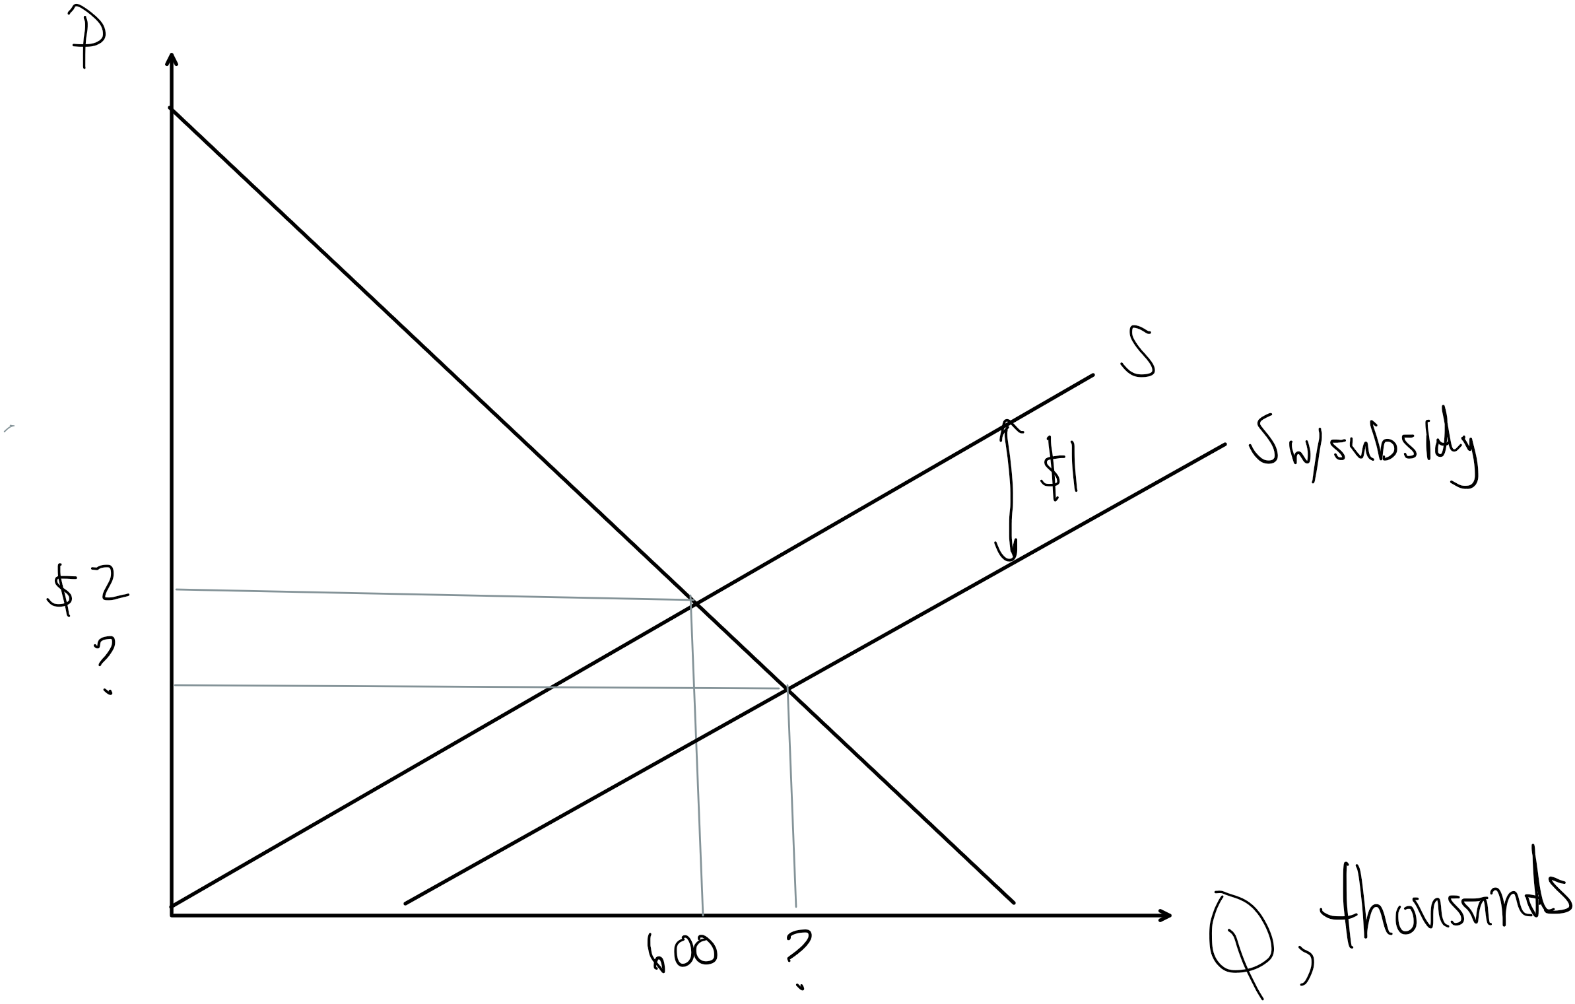
The market for broccoli in Ironia is characterized by weekly demand and supply equations, with Q in thousands of bushels: Qd=1000-200P
Qs=300P
With no market intervention, the equilibrium price of broccoli is $2 and the quantity sold is 600,000 bushels.
Find the deadweight loss in this market if the government decides to subsidize broccoli purchases by giving producers a $1 subsidy per bushel sold. The new supply curve is given by Qs=300P+300.

Slide 25
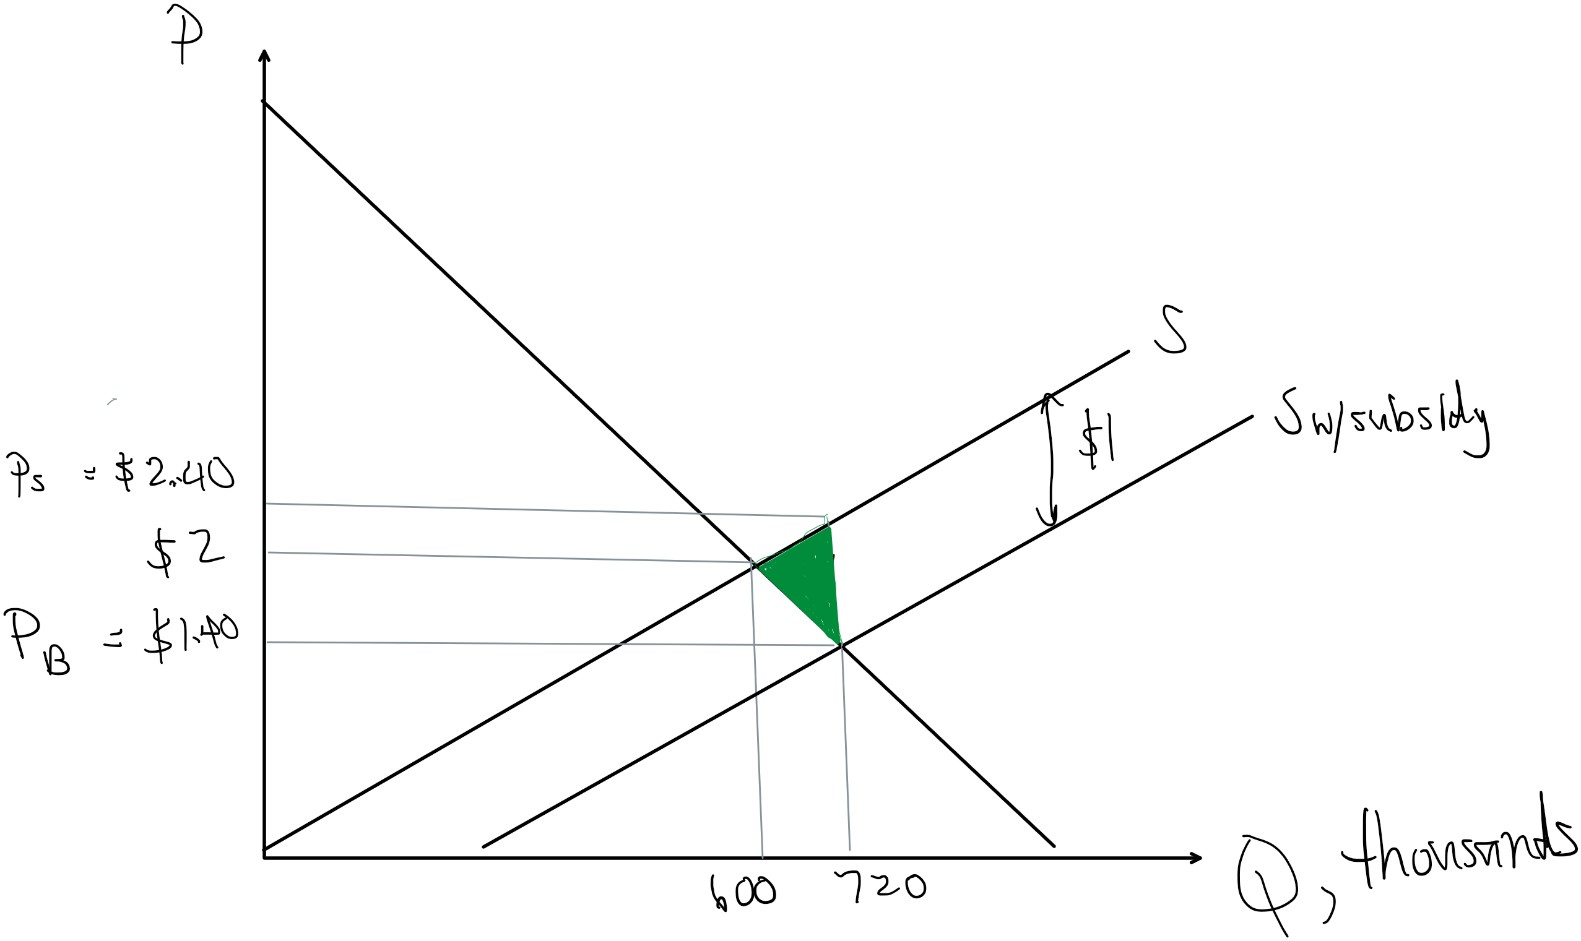
The market for broccoli in Ironia is characterized by weekly demand and supply equations, with Q in thousands of bushels: Qd=1000-200P
Qs=300P
With no market intervention, the equilibrium price of broccoli is $2 and the quantity sold is 600,000 bushels.
Find the deadweight loss in this market if the government decides to subsidize broccoli purchases by giving producers a $1 subsidy per bushel sold. The new supply curve is given by Qs=300P+300.
DWL= ½ ($1)(720,000-600,000)
=$60,000

Slide 26
